Slide 1
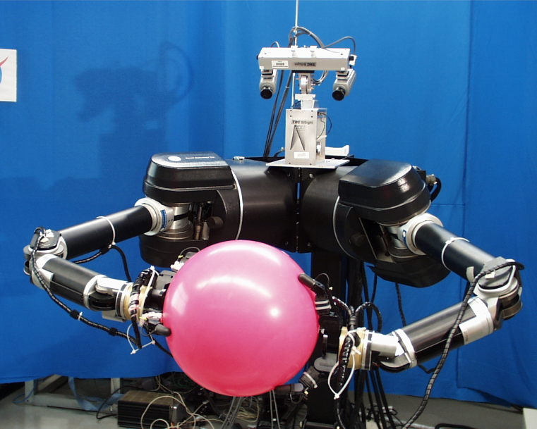
Online Algorithms
Lecturer: Yishay Mansour
Elad Walach
Alex Roitenberg

Slide 2
Introduction
Up until now, our algorithms start with input and work with it
suppose input arrives a little at a time, need instant response

Slide 3
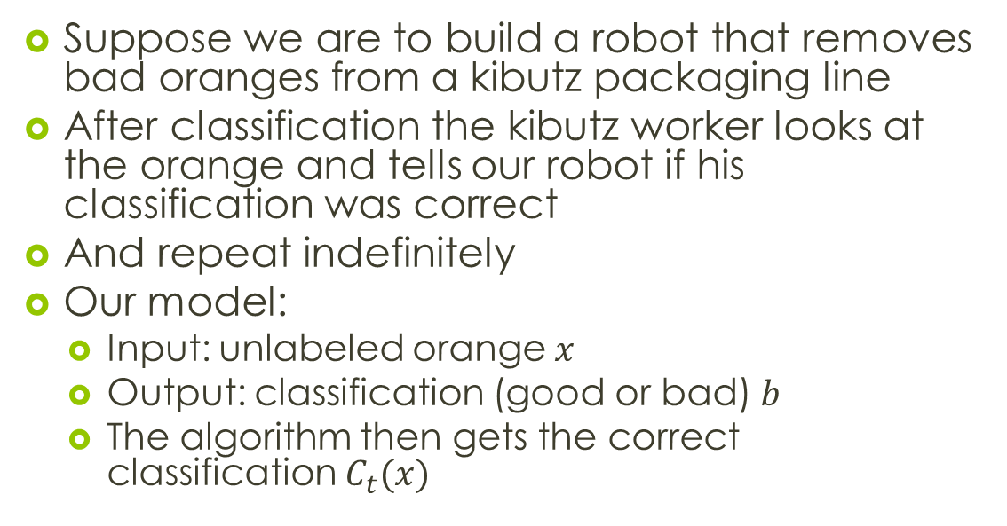
Oranges example
Suppose we are to build a robot that removes bad oranges from a kibutz packaging line
After classification the kibutz worker looks at the orange and tells our robot if his classification was correct
And repeat indefinitely
Our model:
Input: unlabeled orange $x$
Output: classification (good or bad) $b$
The algorithm then gets the correct classification $C_{t}(x)$

Slide 4
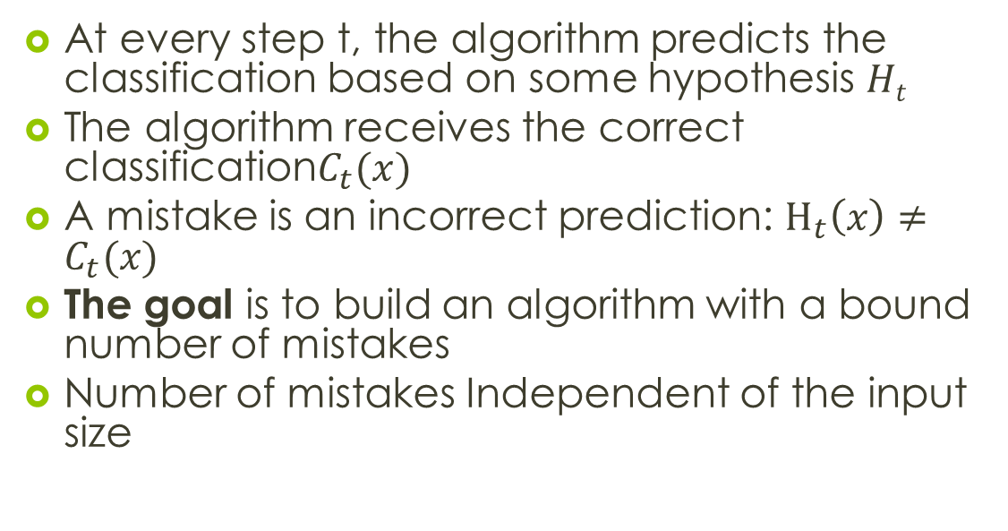
Introduction
At every step t, the algorithm predicts the classification based on some hypothesis $Ht$
The algorithm receives the correct classification$C_{t}(x)$
A mistake is an incorrect prediction: $H_{t}\left(x\right)≠C_{t}(x)$
The goal is to build an algorithm with a bound number of mistakes
Number of mistakes Independent of the input size

Slide 5
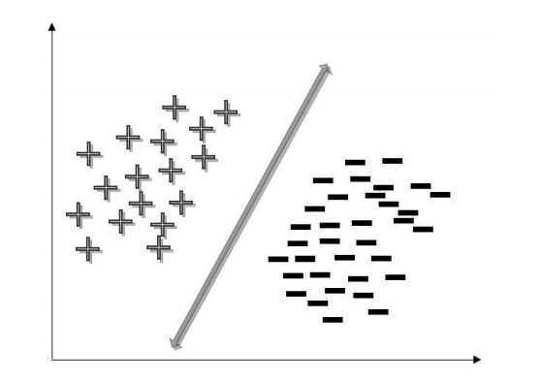
Linear Separators

Slide 6
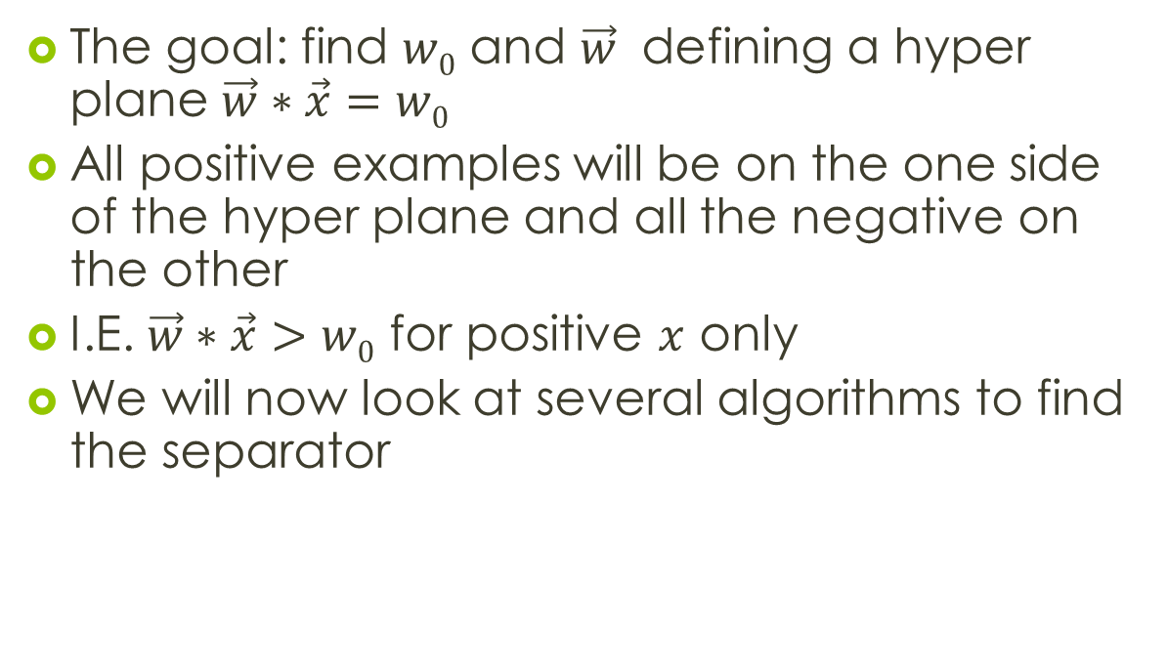
Linear saperator
The goal: find $w0$ and $\vec{w}$ defining a hyper plane $\vec{w}∗\vec{x}=w0$
All positive examples will be on the one side of the hyper plane and all the negative on the other
I.E. $\vec{w}∗\vec{x}>w0$ for positive $x$ only
We will now look at several algorithms to find the separator

Slide 7
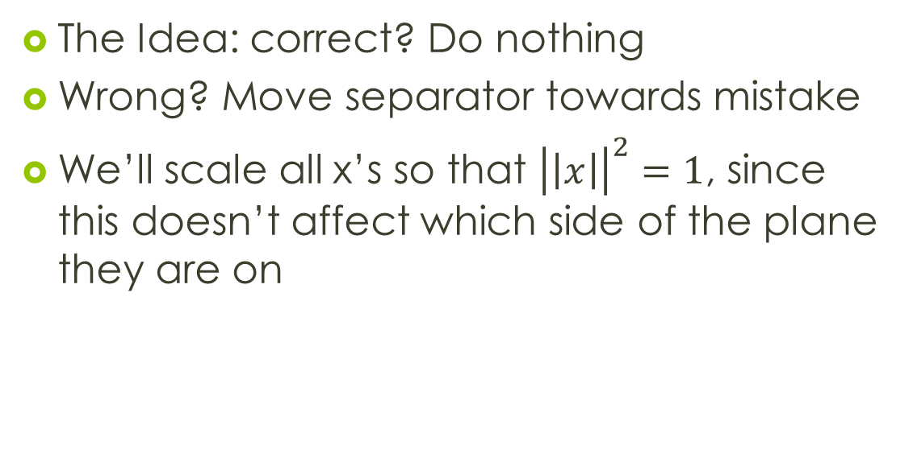
Perceptron
The Idea: correct? Do nothing
Wrong? Move separator towards mistake
We’ll scale all x’s so that ${\left|\left|x\right|\right|}^{2}=1$, since this doesn’t affect which side of the plane they are on

Slide 8
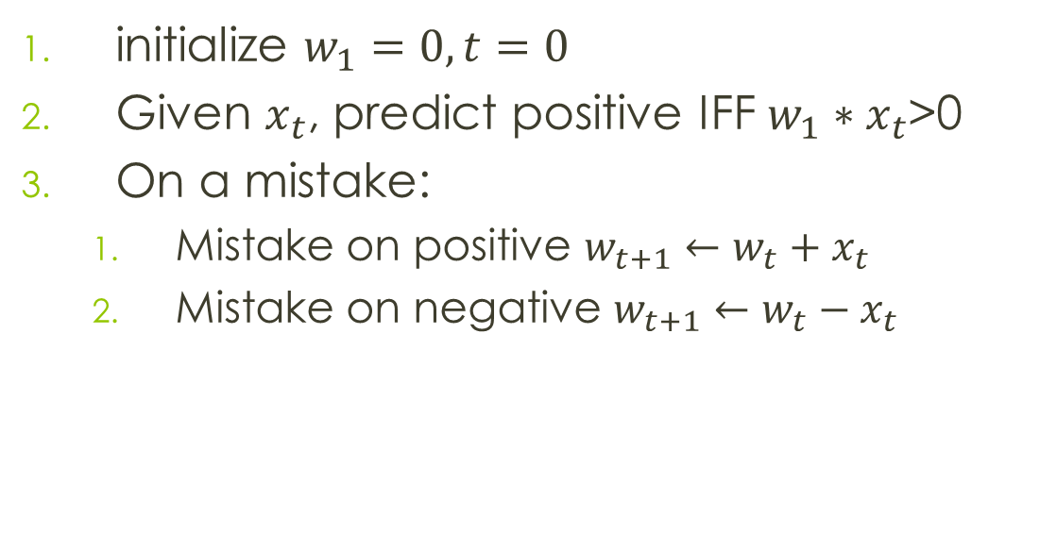
The perceptron algorithm
initialize $w_{1}=0, t=0$
Given $x_{t}$, predict positive IFF $w_{1}∗x_{t}$>0
On a mistake:
Mistake on positive $w_{t+1}←w_{t}+x_{t}$
Mistake on negative $w_{t+1}←w_{t}−x_{t}$

Slide 9
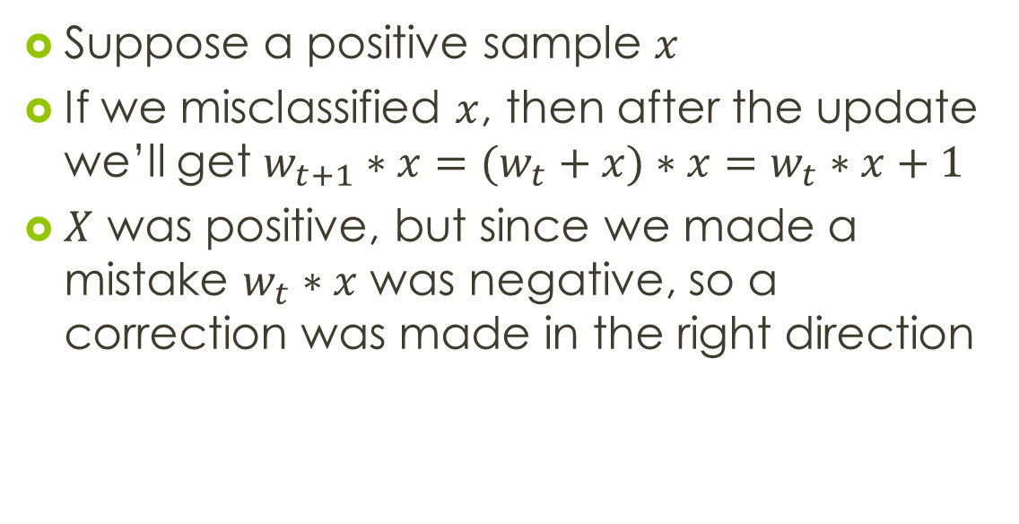
The perceptron algorithm
Suppose a positive sample $x$
If we misclassified $x$, then after the update we’ll get $w_{t+1}∗x=(w_{t}+x)∗x=w_{t}∗x+1$
$X$ was positive, but since we made a mistake $w_{t}∗x$ was negative, so a correction was made in the right direction

Slide 10
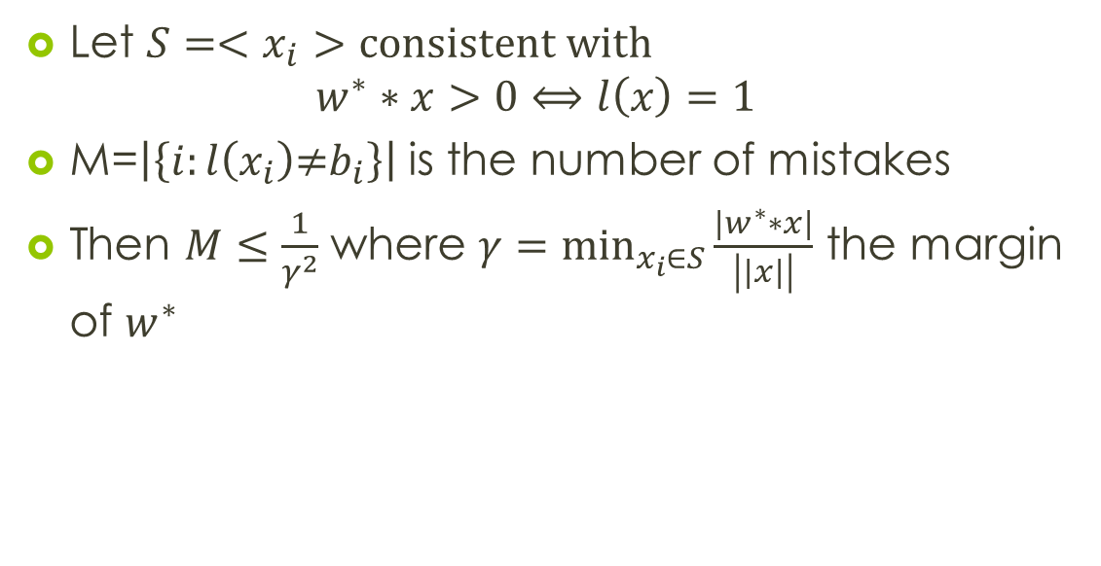

Mistake Bound Theorem
Let $S=<x_{i}>$ $\text{consistent} \text{with}$
$$w^{∗}∗x>0⟺l\left(x\right)=1$$
M=$\left|\left\{i:l\left(x_{i}\right)\text{≠}b_{i}\right\}\right|$ is the number of mistakes
Then $M≤\frac{1}{γ^{2}}$ where $γ=\min_{x_{i}∈S}{\frac{\left|w^{∗}∗x\right|}{\left|\left|x\right|\right|}}$ the margin of $w^{∗}$
Intuition:
the minimal distance of the samples in S from $w^{∗}$(after normalizing both $w^{∗}$ and the samples)

Slide 11
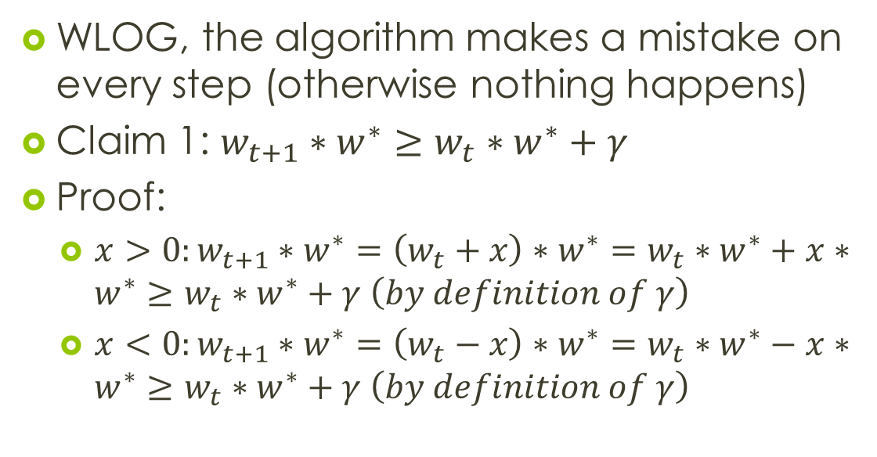
Mistake Bound Proof
WLOG, the algorithm makes a mistake on every step (otherwise nothing happens)
Claim 1: $w_{t+1}∗w^{∗}≥w_{t}∗w^{∗}+γ$
Proof:
$x>0:w_{t+1}∗w^{∗}=\left(w_{t}+x\right)∗w^{∗}=w_{t}∗w^{∗}+x∗w^{∗}≥w_{t}∗w^{∗}+γ \left(by definition of γ\right)$
$x<0:w_{t+1}∗w^{∗}=\left(w_{t}−x\right)∗w^{∗}=w_{t}∗w^{∗}−x∗w^{∗}≥w_{t}∗w^{∗}+γ \left(by definition of γ\right)$

Slide 12
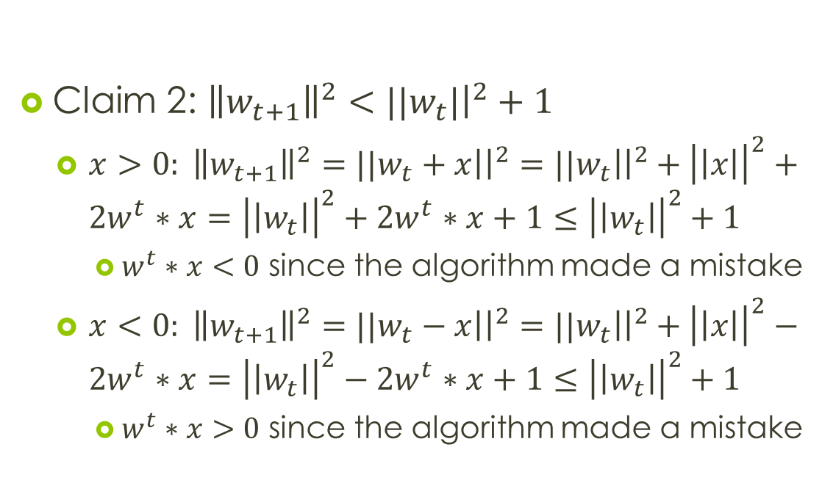
Proof Cont.
Claim 2: ${\left\|w_{t+1}\right\|}^{2}<{||w}_{t}|{\left.​\right|}^{2}+1$
${x>0: \left\|w_{t+1}\right\|}^{2}={||w}_{t}+x\left|{\left.​\right|}^{2}={||w}_{t}\right|{\left.​\right|}^{2}+{\left|\left|x\right|\right|}^{2}+2w^{t}∗x={\left|\left|w_{t}\right|\right|}^{2}+2w^{t}∗x+1≤{\left|\left|w_{t}\right|\right|}^{2}+1$
$w^{t}∗x<0$ since the algorithm made a mistake
${x<0: \left\|w_{t+1}\right\|}^{2}={||w}_{t}−x\left|{\left.​\right|}^{2}={||w}_{t}\right|{\left.​\right|}^{2}+{\left|\left|x\right|\right|}^{2}−2w^{t}∗x={\left|\left|w_{t}\right|\right|}^{2}−2w^{t}∗x+1≤{\left|\left|w_{t}\right|\right|}^{2}+1$
$w^{t}∗x>0$ since the algorithm made a mistake

Slide 13
Proof Cont.
From Claim 1:
From Claim 2:
Also:
Since
Combining:

Slide 14
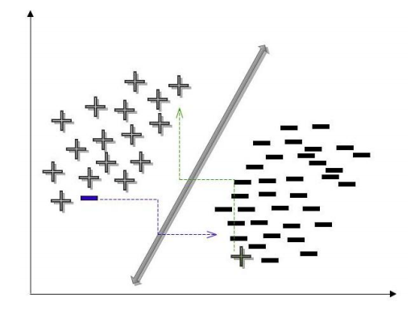
The world is not perfect
What if there is no perfect separator?

Slide 15
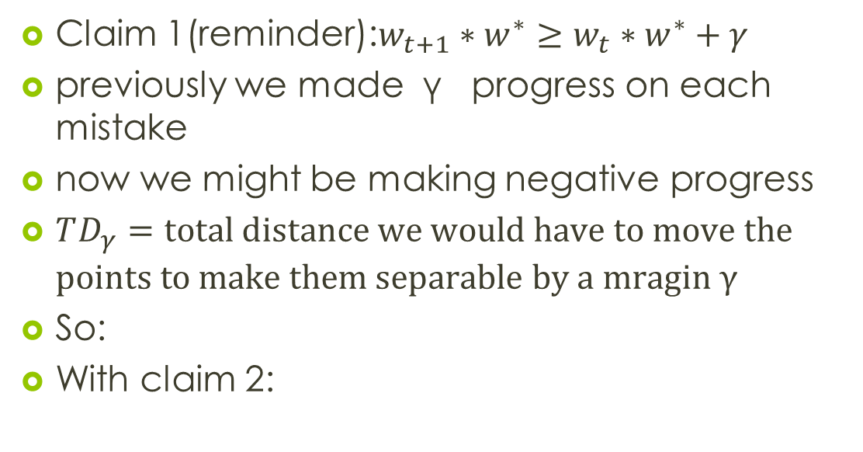
The world is not perfect
Claim 1(reminder):$w_{t+1}∗w^{∗}≥w_{t}∗w^{∗}+γ$
previously we made γ progress on each mistake
now we might be making negative progress
$TD_{γ}=\text{total} \text{distance} \text{we} \text{would} \text{have} \text{to} \text{move} \text{the} \text{points} \text{to} \text{make} \text{them} \text{separable} \text{by} \text{a} \text{mragin} \text{γ}$
So:
With claim 2:

Slide 16
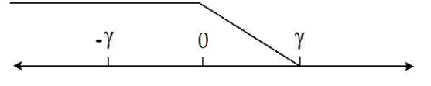
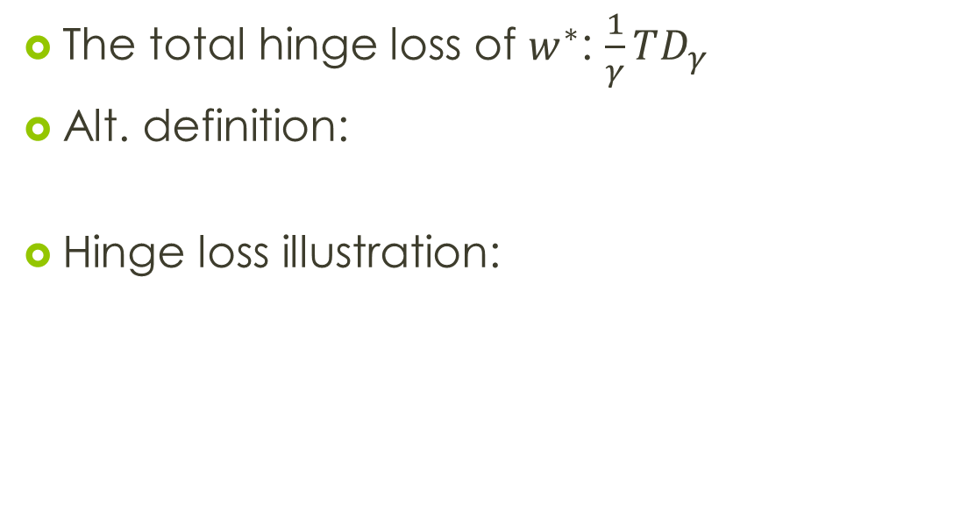
The world is not perfect
The total hinge loss of $w^{∗}$: $\frac{1}{γ}TD_{γ}$
Alt. definition:
Hinge loss illustration:

Slide 17
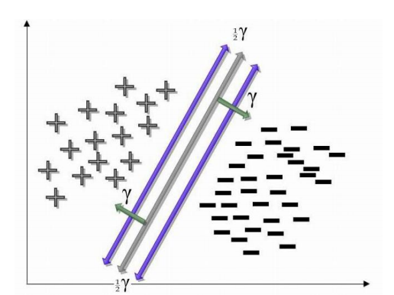
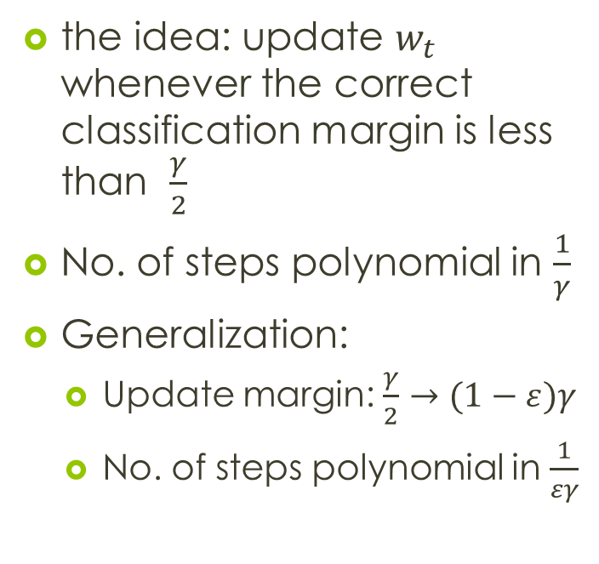
Perceptron for maximizing margins
the idea: update $w_{t}$ whenever the correct classification margin is less than $\frac{γ}{2}$
No. of steps polynomial in $\frac{1}{γ}$
Generalization:
Update margin: $\frac{γ}{2}→(1−ε)γ$
No. of steps polynomial in $\frac{1}{εγ}$

Slide 18
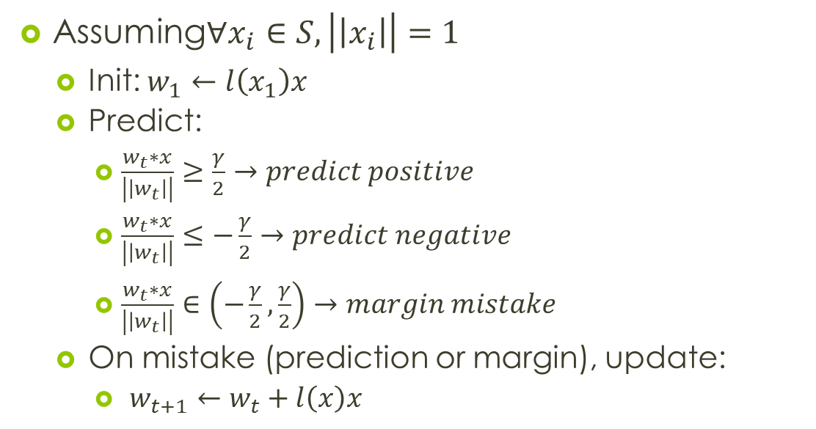
Perceptron Algorithm (maximizing margin)
Assuming$∀x_{i}∈S,\left|\left|x_{i}\right|\right|=1$
Init: $w_{1}←l\left(x_{1}\right)x$
Predict:
$\frac{w_{t}∗x}{\left|\left|w_{t}\right|\right|}≥\frac{γ}{2}→predict positive$
$\frac{w_{t}∗x}{\left|\left|w_{t}\right|\right|}≤−\frac{γ}{2}→predict negative$
$\frac{w_{t}∗x}{\left|\left|w_{t}\right|\right|}∈\left(−\frac{γ}{2},\frac{γ}{2}\right)→margin mistake$
On mistake (prediction or margin), update:
$w_{t+1}←w_{t}+l\left(x\right)x$

Slide 19
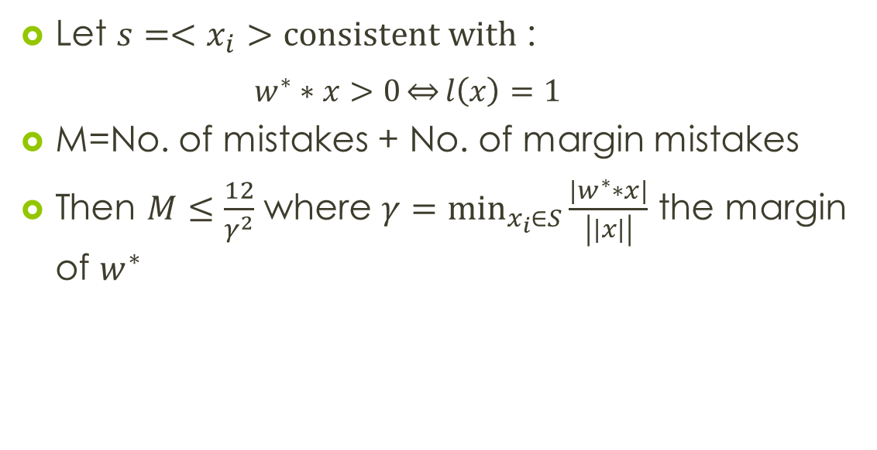
Mistake Bound Theorem
Let $s=<x_{i}>$ $\text{consistent} \text{with}$ :
$$w^{∗}∗x>0\underset{⇔}{}l\left(x\right)=1$$
M=No. of mistakes + No. of margin mistakes
Then $M≤\frac{12}{γ^{2}}$ where $γ=\min_{x_{i}∈S}{\frac{\left|w^{∗}∗x\right|}{\left|\left|x\right|\right|}}$ the margin of $w^{∗}$
Intuition:
similar to the perceptron proof.
Claim 1 remains the same:
We only have to bound

Slide 20
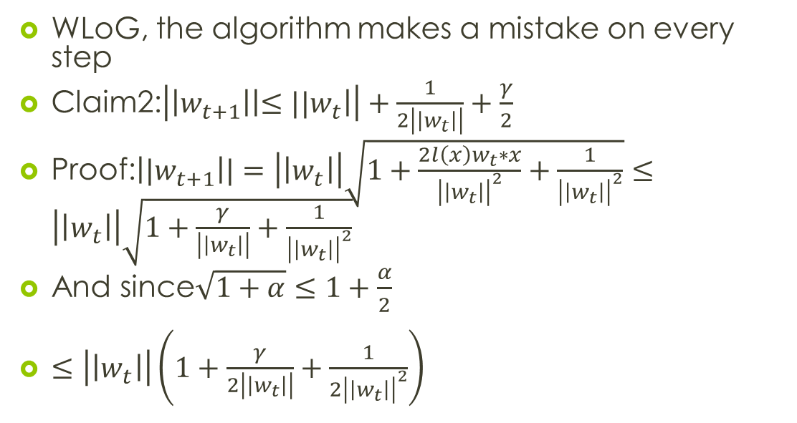
Mistake bound proof
WLoG, the algorithm makes a mistake on every step
Claim2:$\left|\left|w_{t+1}\right|\left|≤{||w}_{t}\right|\right|+\frac{1}{2\left|\left|w_{t}\right|\right|}+\frac{γ}{2}$
Proof:$\left|{|w}_{t+1}\right||=\left|\left|w_{t}\right|\right|\sqrt{1+\frac{2l\left(x\right)w_{t}∗x}{{\left|\left|w_{t}\right|\right|}^{2}}+\frac{1}{{\left|\left|w_{t}\right|\right|}^{2}}}≤\left|\left|w_{t}\right|\right|\sqrt{1+\frac{γ}{\left|\left|w_{t}\right|\right|}+\frac{1}{{\left|\left|w_{t}\right|\right|}^{2}}}$
And since$\sqrt{1+α}≤1+\frac{α}{2}$
$≤\left|\left|w_{t}\right|\right|\left(1+\frac{γ}{2\left|\left|w_{t}\right|\right|}+\frac{1}{{2\left|\left|w_{t}\right|\right|}^{2}}\right)$

Slide 21
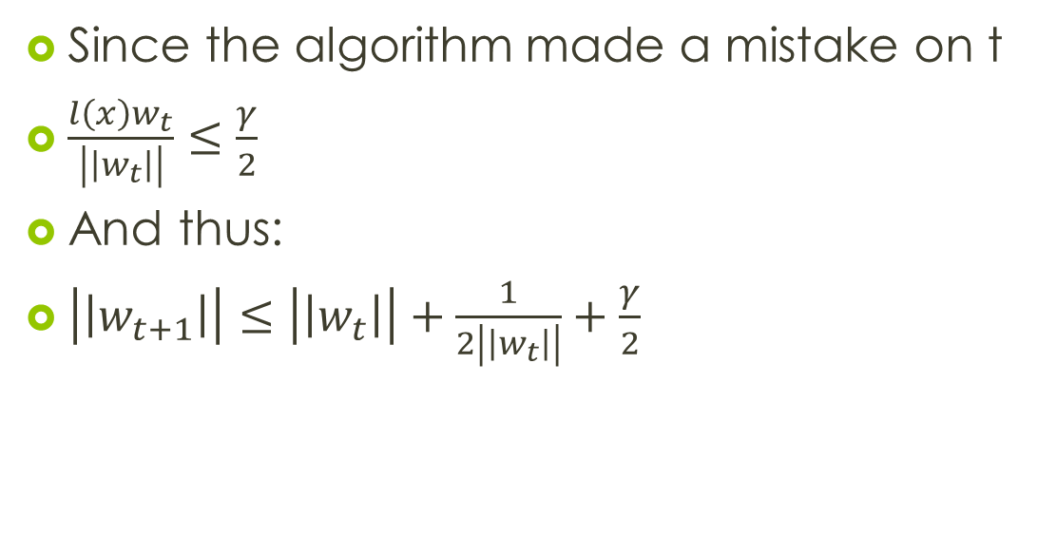
Proof Cont.
Since the algorithm made a mistake on t
$\frac{l\left(x\right)w_{t}}{\left|\left|w_{t}\right|\right|}≤\frac{γ}{2}$
And thus:
$\left|\left|w_{t+1}\right|\right|≤\left|\left|w_{t}\right|\right|+\frac{1}{2\left|\left|w_{t}\right|\right|}+\frac{γ}{2}$

Slide 22
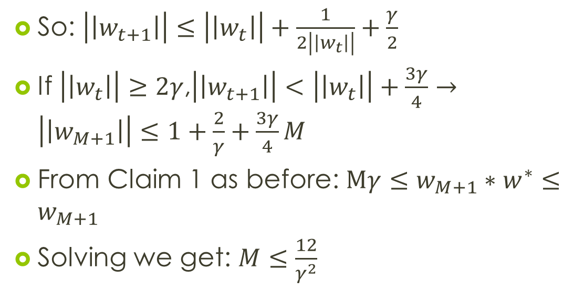
Proof Cont.
So: $\left|\left|w_{t+1}\right|\right|≤\left|\left|w_{t}\right|\right|+\frac{1}{2\left|\left|w_{t}\right|\right|}+\frac{γ}{2}$
If $\left|\left|w_{t}\right|\right|≥2γ$,$\left|\left|w_{t+1}\right|\right|<\left|\left|w_{t}\right|\right|+\frac{3γ}{4}→\left|\left|w_{M+1}\right|\right|≤1+\frac{2}{γ}+\frac{3γ}{4}M$
From Claim 1 as before: $Mγ≤w_{M+1}∗w^{∗}≤w_{M+1}$
Solving we get: $M≤\frac{12}{γ^{2}}$

Slide 23
The mistake bound model

Slide 24
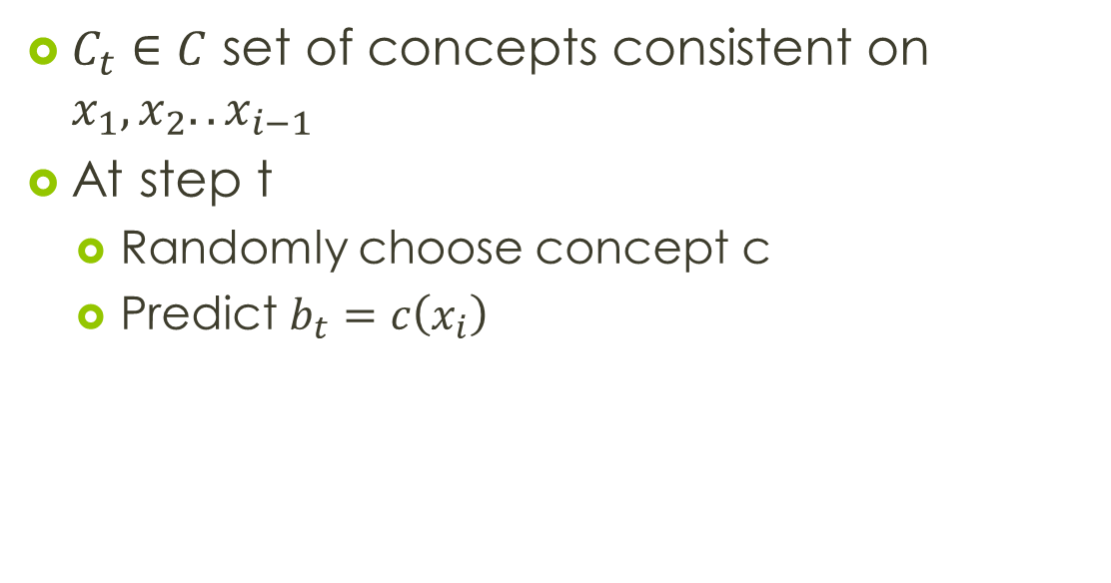
Con Algorithm
$C_{t}∈C$ set of concepts consistent on $x_{1},x_{2}..x_{i−1}$
At step t
Randomly choose concept c
Predict $b_{t}=c\left(x_{i}\right)$

Slide 25
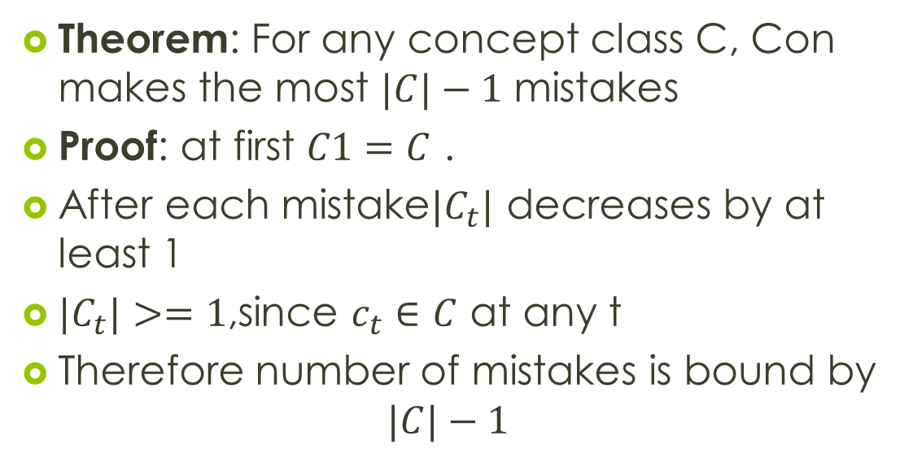
CON Algorithm
Theorem: For any concept class C, Con makes the most $|C|−1$ mistakes
Proof: at first $C1=C$ .
After each mistake$|C_{t}|$ decreases by at least 1
${|C}_{t}|>=1$,since $c_{t}∈C$ at any t
Therefore number of mistakes is bound by
$$|C|−1$$

Slide 26
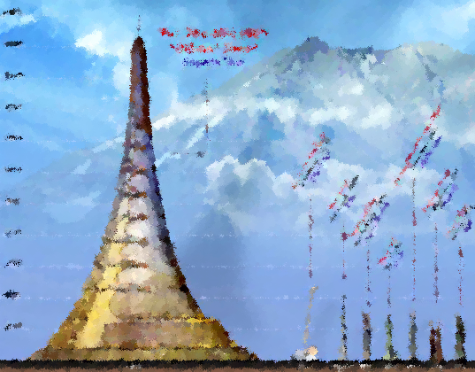
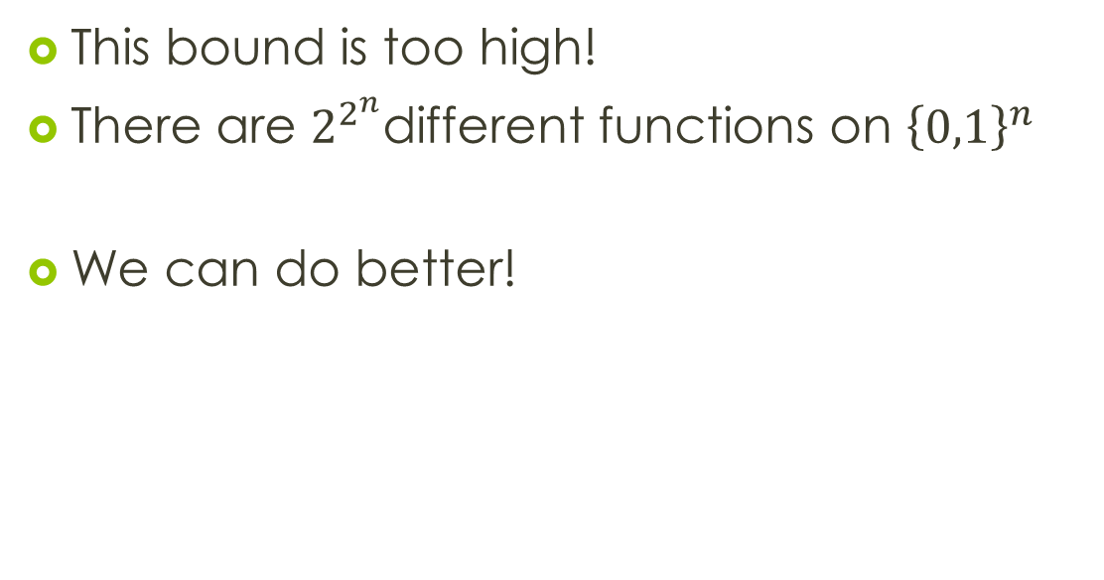
The bounds of CON
This bound is too high!
There are $2^{2^{n}}$different functions on ${\left\{0,1\right\}}^{n}$
We can do better!

Slide 27
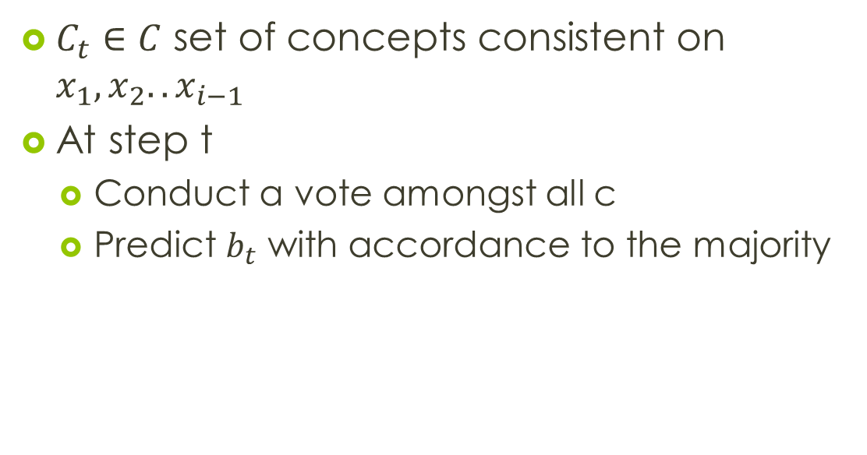
HAL – halving algorithm
$C_{t}∈C$ set of concepts consistent on $x_{1},x_{2}..x_{i−1}$
At step t
Conduct a vote amongst all c
Predict $b_{t}$ with accordance to the majority

Slide 28
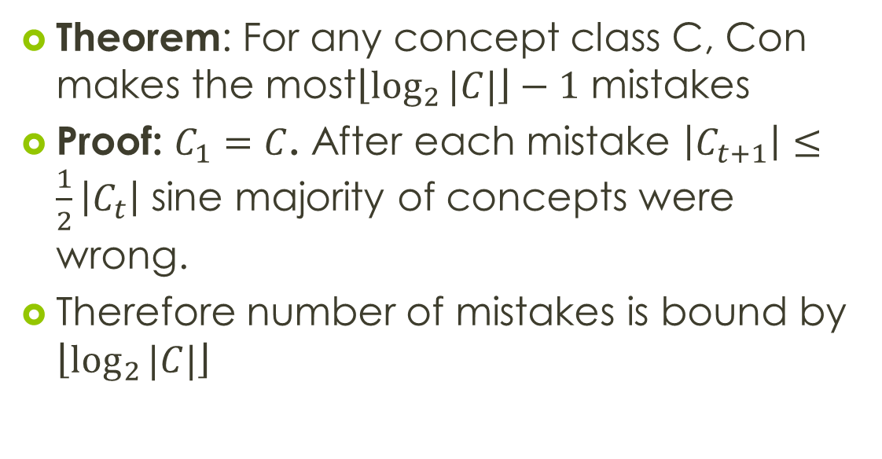
HAL –halving algorithm
Theorem: For any concept class C, Con makes the most$\left\lfloor \log_{2}{|C|}\right\rfloor −1$ mistakes
Proof: $C_{1}=C$. After each mistake $\left|C_{t+1}\right|≤\frac{1}{2}\left|C_{t}\right|$ sine majority of concepts were wrong.
Therefore number of mistakes is bound by $\left\lfloor \log_{2}{|C|}\right\rfloor$

Slide 29
Mistake Bound model and PAC
Generates strong online algorithms
In the past we have seen PAC
Restrictions for mistake bound are much harsher than PAC
If we know that A learns C in mistake bound model , should A learn C in PAC model?

Slide 30
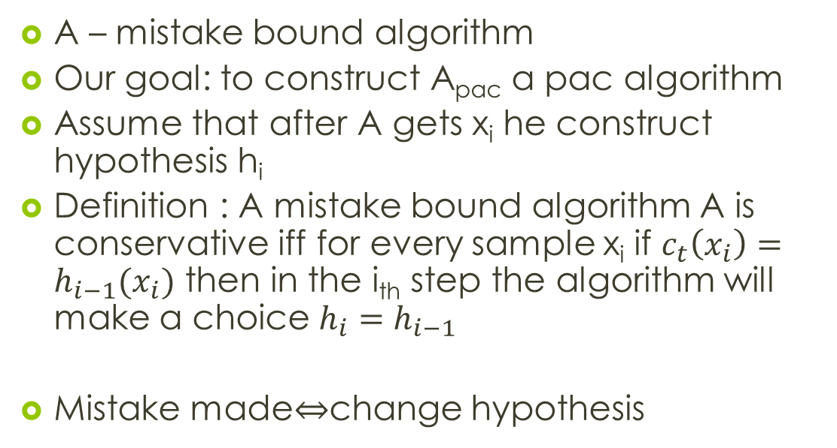
Mistake Bound model and PAC
A – mistake bound algorithm
Our goal: to construct A_{pac} a pac algorithm
Assume that after A gets x_{i} he construct hypothesis h_{i}
Definition : A mistake bound algorithm A is conservative iff for every sample x_{i} if $c_{t}\left(x_{i}\right)=h_{i−1}(x_{i})$ then in the i_{th} step the algorithm will make a choice $h_{i}=h_{i−1}$
Mistake made$⇔$change hypothesis

Slide 31
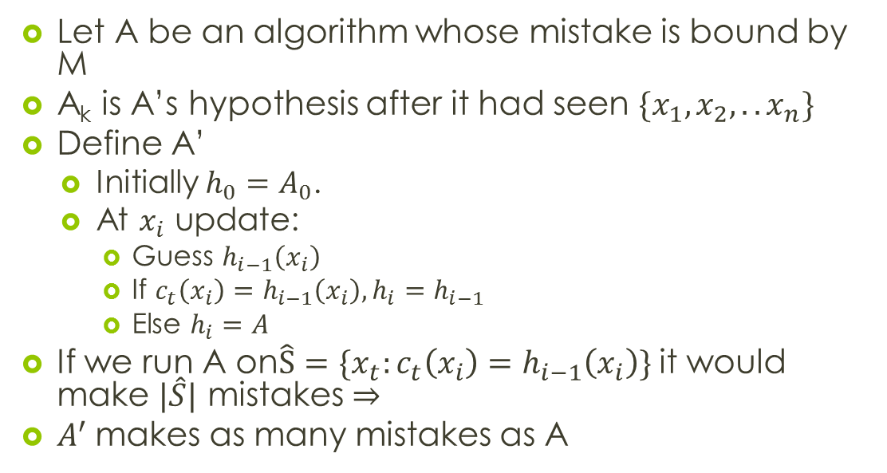
Conservative equivalent of Mistake Bound Algorithm
Let A be an algorithm whose mistake is bound by M
A_{k} is A’s hypothesis after it had seen $\{x_{1},x_{2},..x_{n}\}$
Define A’
Initially $h_{0}=A_{0}$.
At $x_{i}$ update:
Guess $h_{i−1}\left(x_{i}\right)$
If $c_{t}\left(x_{i}\right)=h_{i−1}\left(x_{i}\right),h_{i}=h_{i−1}$
Else $h_{i}=A$
If we run A on$\hat{S}=\{x_{t}:c_{t}\left(x_{i}\right)=h_{i−1}\left(x_{i}\right)\}$ it would make $|\hat{S}|$ mistakes $⇒$
$A^{′}$makes as many mistakes as A

Slide 32
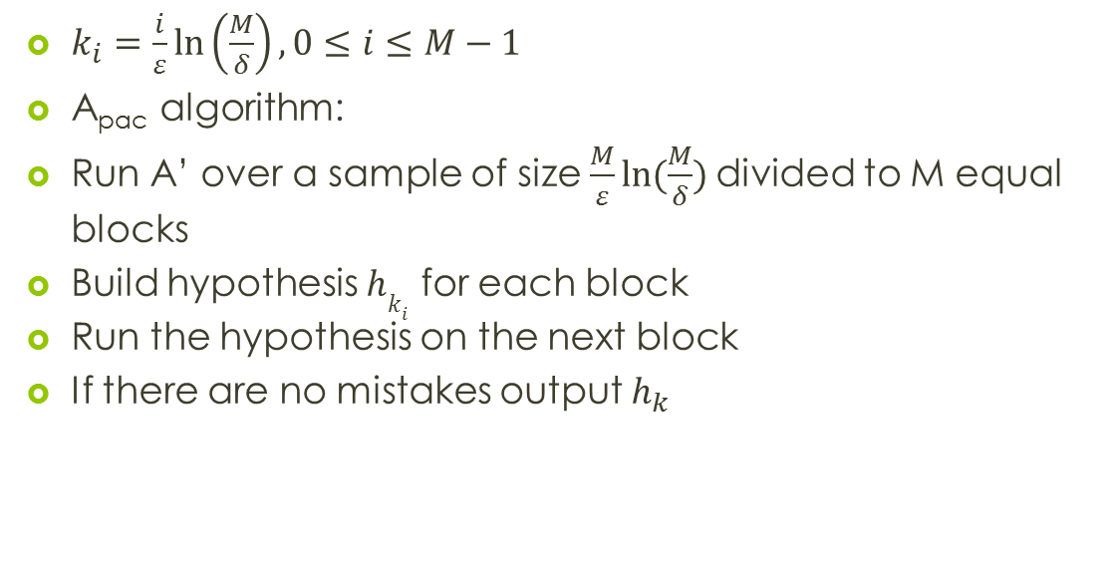
Building A_{pac}
$k_{i}=\frac{i}{ε}\ln\left(\frac{M}{δ}\right),0≤i≤M−1$
A_{pac} algorithm:
Run A’ over a sample of size $\frac{M}{ε}ln⁡(\frac{M}{δ})$divided to M equal blocks
Build hypothesis $hk_{i}$ for each block
Run the hypothesis on the next block
If there are no mistakes output $h_{k}$
inconsistent
inconsistent
…
consistent
consistent

Slide 33
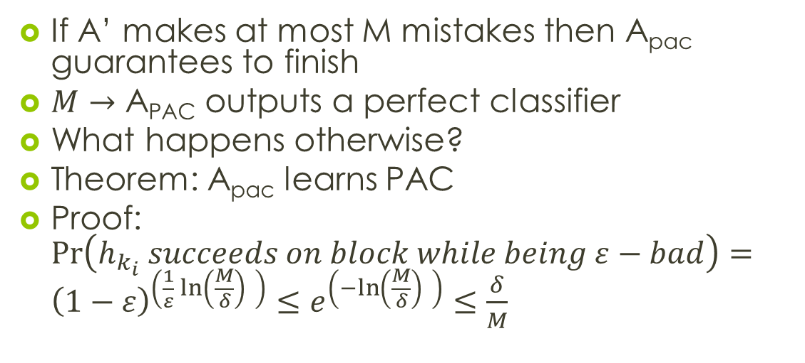
Building A_{pac}
If A’ makes at most M mistakes then A_{pac} guarantees to finish
$M→\text{A}\text{PAC}$ outputs a perfect classifier
What happens otherwise?
Theorem: A_{pac} learns PAC
Proof: $\operatorname{Pr}\left(h_{k_{i}} succeeds on block while being ε−bad\right)={\left(1−ε\right)}^{\left(\frac{1}{ε}\ln\left(\frac{M}{δ}\right) \right)}≤e^{\left(−ln\left(\frac{M}{δ}\right) \right)}≤\frac{δ}{M}$

Slide 34
Disjunction of Conjuctions

Slide 35
Disjunction of Conjunctions
We have proven that every algorithm in mistake bound model can be converted to PAC
Lets look at some algorithms in the mistake bound model

Slide 36
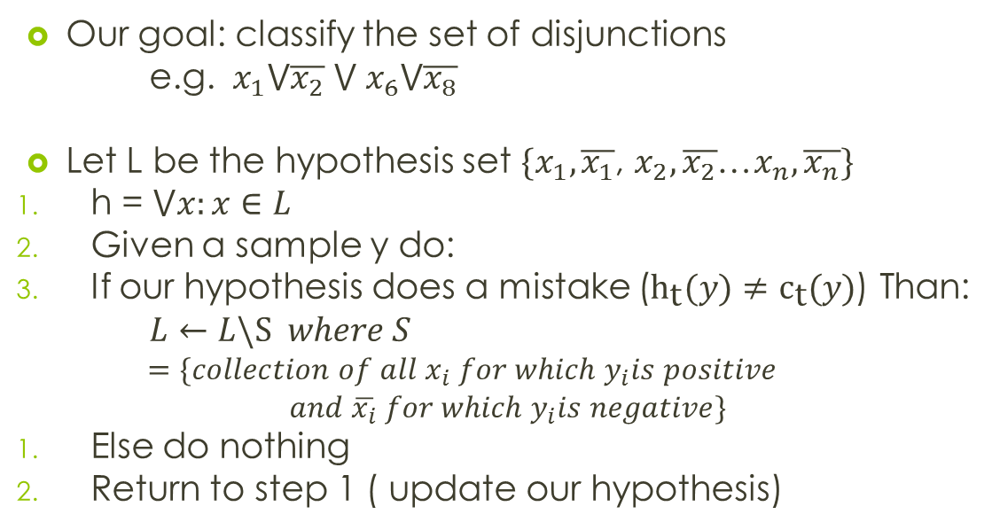
Disjunction Learning
Our goal: classify the set of disjunctions
e.g. $x_{1}⋁\overline{x_{2}}$ $⋁ x_{6}⋁\overline{x_{8}}$
Let L be the hypothesis set $\{x_{1},\overline{x_{1}}$, $x_{2},\overline{x_{2}}$…$x_{n},\overline{x_{n}}\}$
h = $⋁x:x∈L$
Given a sample y do:
If our hypothesis does a mistake (${\text{h}}_{\text{t}}(y)≠{\text{c}}_{\text{t}}(y)$) Than:
$L←L\backslash S where S$
$$=\{collection of all x_{i} for which y_{i}is positive$$
$and \overline{x_{i}} for which y_{i}is negative\}$
Else do nothing
Return to step 1 ( update our hypothesis)

Slide 37
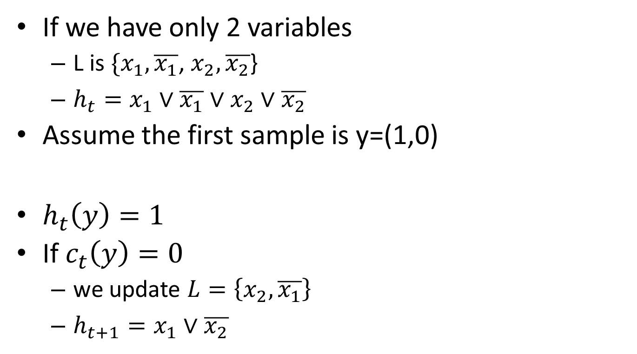
Example
If we have only 2 variables
L is $\{x_{1},\overline{x_{1}}$, $x_{2},\overline{x_{2}}$}
$h_{t}=x_{1}∨\overline{x_{1}}∨x_{2}∨\overline{x_{2}}$
Assume the first sample is y=(1,0)
$h_{t}\left(y\right)=1$
If $c_{t}\left(y\right)=0$
we update $L=\left\{x_{2},\overline{x_{1}}\right\}$
$h_{t+1}=x_{1}∨\overline{x_{2}}$

Slide 38
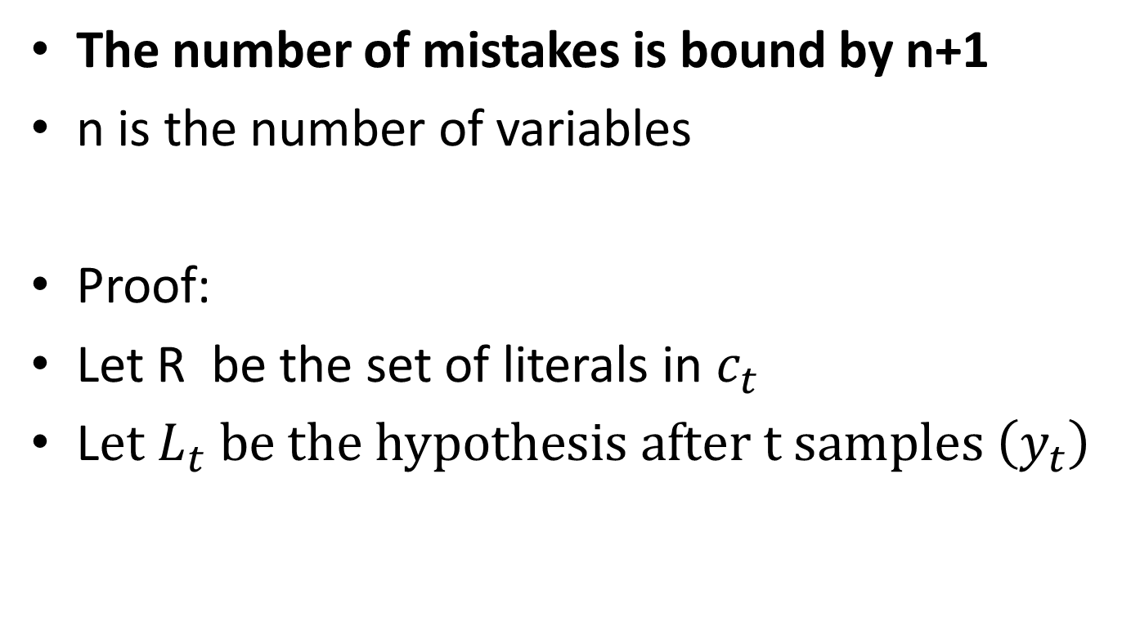
Mistake Bound Analysis
The number of mistakes is bound by n+1
n is the number of variables
Proof:
Let R be the set of literals in $c_{t}$
L$et L_{t} \text{be} \text{the} \text{hypothesis} \text{after} \text{t} \text{samples} \left(y_{t}\right)$

Slide 39
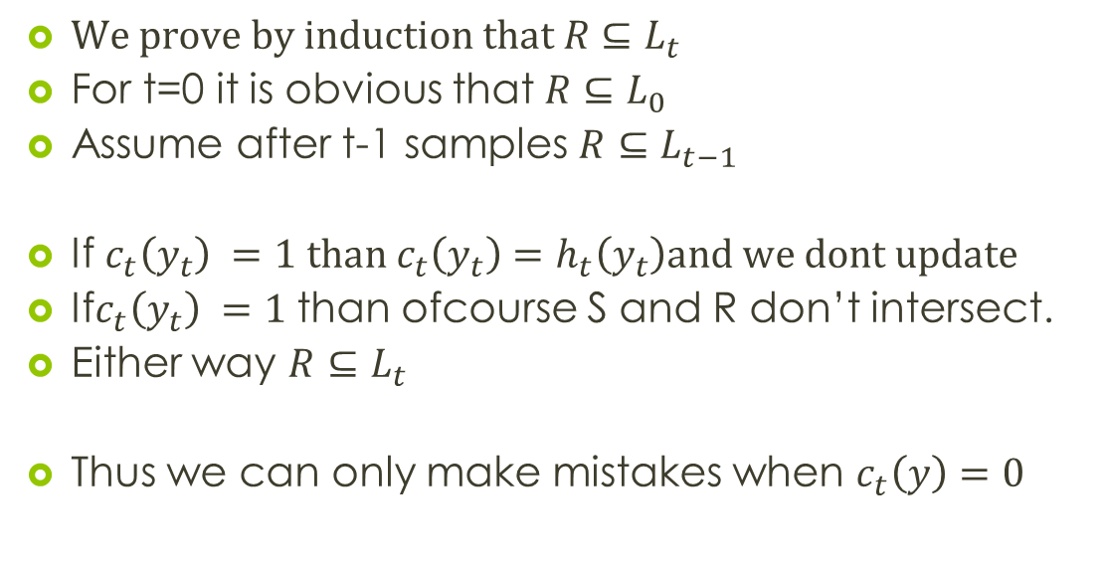
Mistake Bound Analysis
$\text{We} \text{prove} \text{by} \text{induction} \text{that} R⊆L_{t}$
For t=0 it is obvious that $R⊆L_{0}$
Assume after t-1 samples $R⊆L_{t−1}$
If $c_{t}\left(y_{t}\right) =1 \text{than} c_{t}\left(y_{t}\right)=h_{t}\left(y_{t}\right)\text{and} \text{we} \text{dont} \text{update}$
If$c_{t}\left(y_{t}\right) =1$ than ofcourse S and R don’t intersect.
Either way $R⊆L_{t}$
Thus we can only make mistakes when $c_{t}\left(y\right)=0$

Slide 40
Mistake analysis proof
At first mistake we eliminate n literals
At any further mistake we eliminate at least 1 literal
L₀ has 2n literals
So we can have at most n+1 mistakes

Slide 41
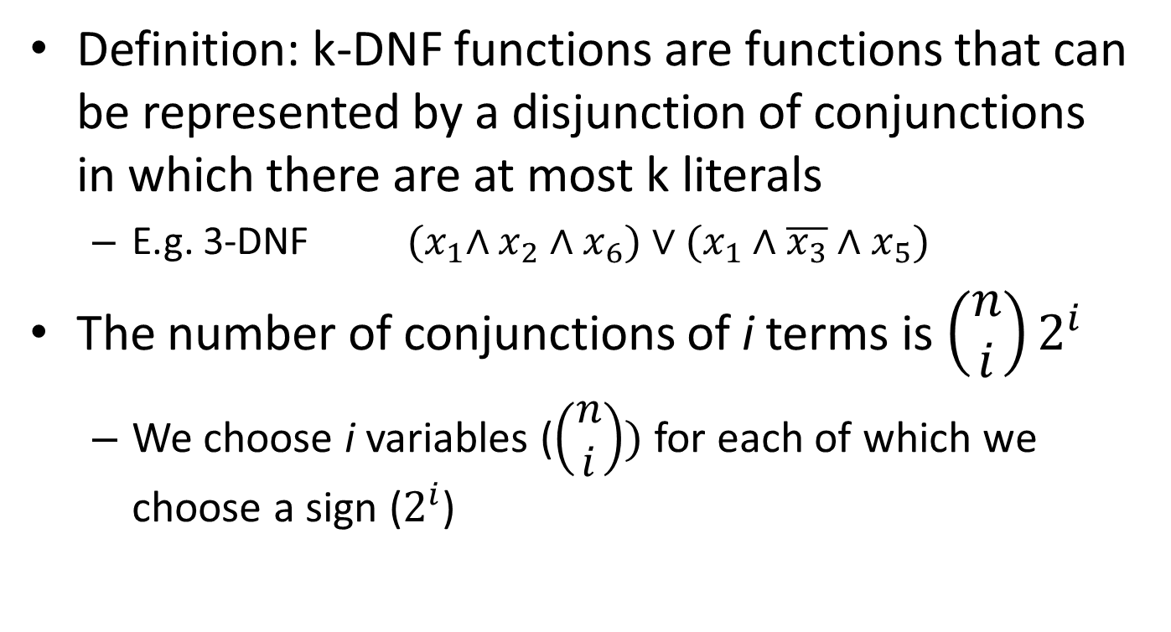
k-DNF
Definition: k-DNF functions are functions that can be represented by a disjunction of conjunctions in which there are at most k literals
E.g. 3-DNF ${(x}_{1}∧x_{2}∧x_{6})∨(x_{1}∧\overline{x_{3}}∧x_{5})$
The number of conjunctions of i terms is $\left(\begin{matrix}n \\ i\end{matrix}\right)2^{i}$
We choose i variables ($\left(\begin{matrix}n \\ i\end{matrix}\right))$ for each of which we choose a sign ($2^{i}$)

Slide 42
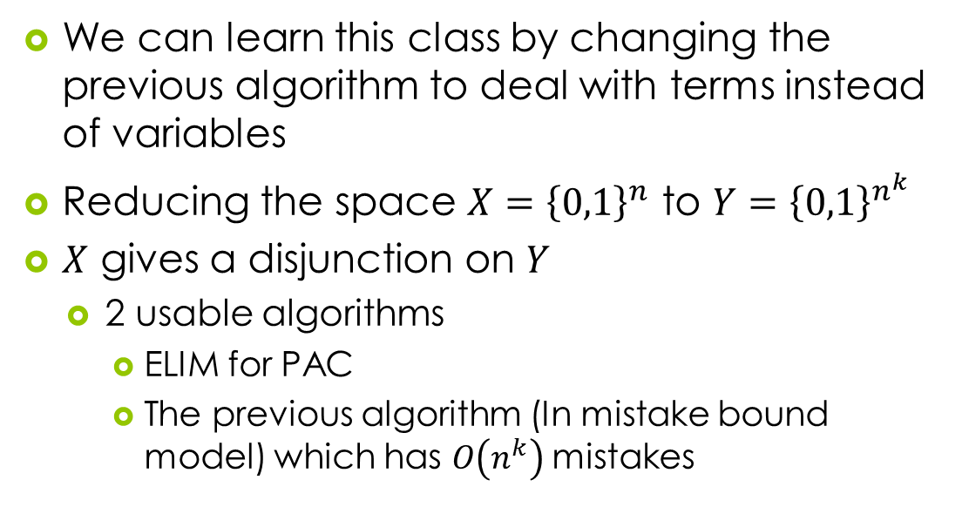
k-DNF classification
We can learn this class by changing the previous algorithm to deal with terms instead of variables
Reducing the space $X={\left\{0,1\right\}}^{n}$ to $Y={\left\{0,1\right\}}^{n^{k}}$
$X$ gives a disjunction on $Y$
2 usable algorithms
ELIM for PAC
The previous algorithm (In mistake bound model) which has $O\left(n^{k}\right)$mistakes

Slide 43
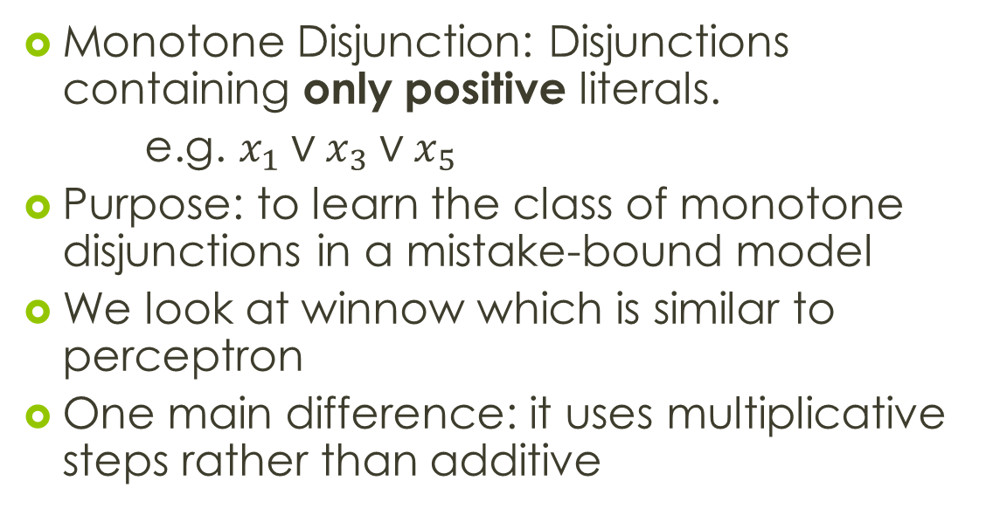
Winnow
Monotone Disjunction: Disjunctions containing only positive literals.
e.g. $x_{1}∨x_{3}∨x_{5}$
Purpose: to learn the class of monotone disjunctions in a mistake-bound model
We look at winnow which is similar to perceptron
One main difference: it uses multiplicative steps rather than additive

Slide 44
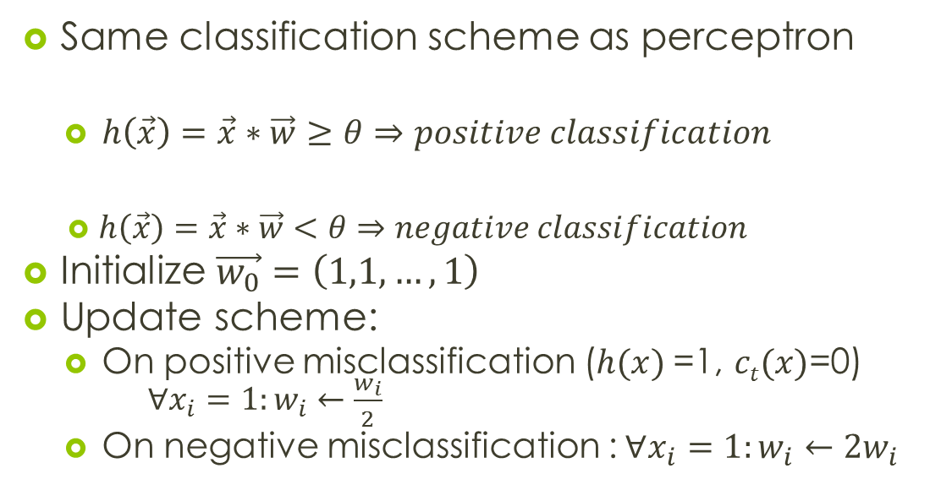
Winnow
Same classification scheme as perceptron
$h\left(\vec{x}\right)=\vec{x}∗\vec{w}≥θ⇒positive classification$
$h\left(\vec{x}\right)=\vec{x}∗\vec{w}<θ⇒negative classification$
Initialize $\vec{w_{0}}=\left(1,1,…,1\right)$
Update scheme:
On positive misclassification ($h(x)$=1, $ct(x)$=0) $∀x_{i}=1:w_{i}←\frac{w_{i}}{2}$
On negative misclassification :$∀x_{i}=1:w_{i}←{2w}_{i}$

Slide 45
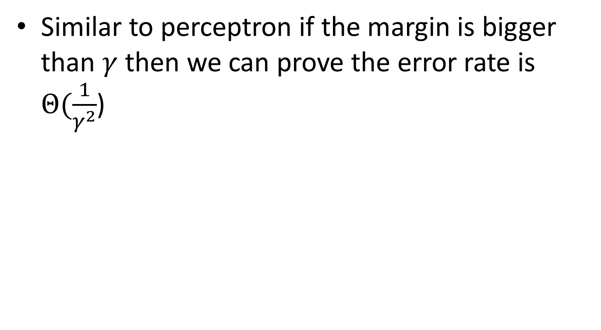
Mistake bound analysis
Similar to perceptron if the margin is bigger than $γ$ then we can prove the error rate is $Θ(\frac{1}{γ^{2}}$)

Slide 46
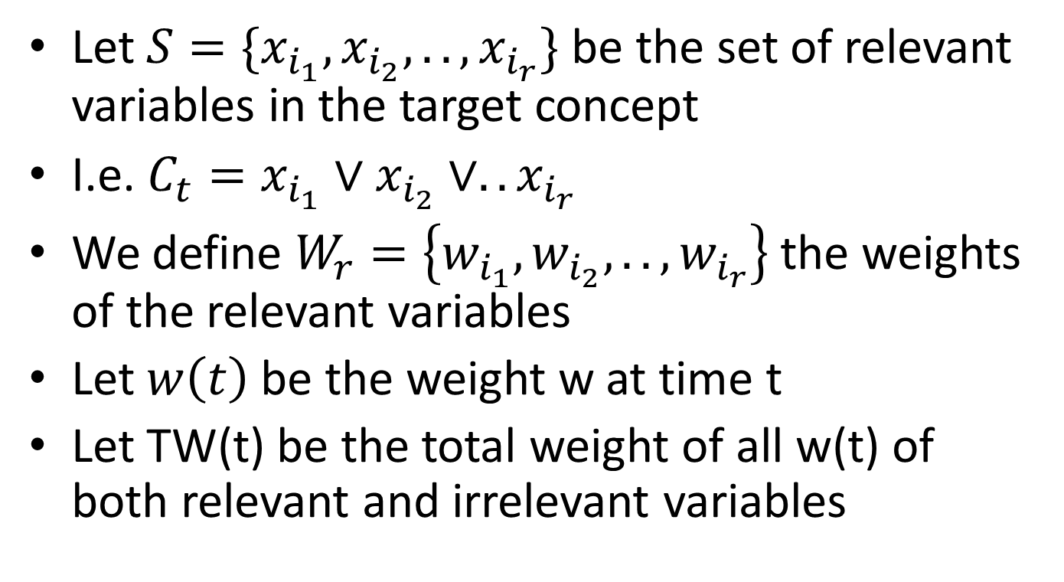
Winnow Proof:Definitions
Let $S=\{x_{i_{1}},x_{i_{2}},..,x_{i_{r}}\}$ be the set of relevant variables in the target concept
I.e. $C_{t}=x_{i_{1}}∨x_{i_{2}}∨..x_{i_{r}}$
We define $W_{r}=\left\{w_{i_{1}},w_{i_{2}},..,w_{i_{r}}\right\}$ the weights of the relevant variables
Let $w\left(t\right)$ be the weight w at time t
Let TW(t) be the total weight of all w(t) of both relevant and irrelevant variables

Slide 47
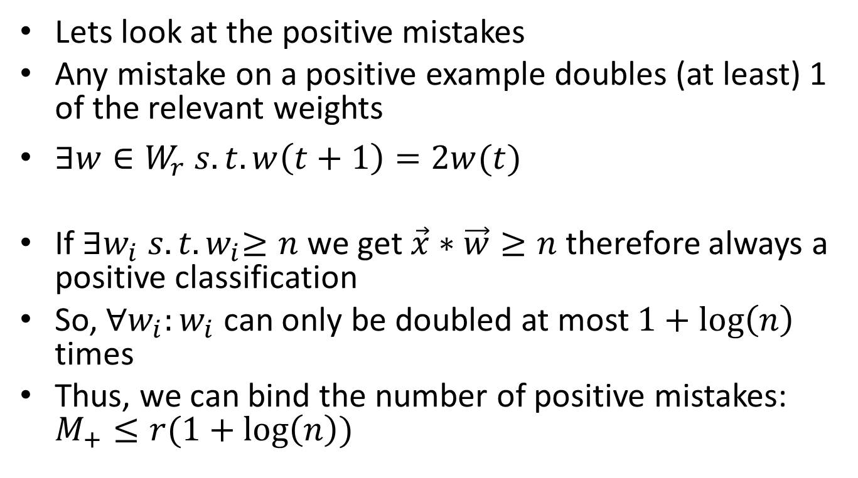
Winnow Proof: Positive Mistakes
Lets look at the positive mistakes
Any mistake on a positive example doubles (at least) 1 of the relevant weights
$∃w∈W_{r} s.t. w\left(t+1\right)=2w(t)$
If ${∃w_{i} s.t. w}_{i}≥n$ we get $\vec{x}∗\vec{w}≥n$ therefore always a positive classification
So, $∀w_{i}:w_{i}$ can only be doubled at most $1+\log\left(n\right)$ times
Thus, we can bind the number of positive mistakes: $M_{+}≤r(1+\log\left(n\right))$

Slide 48
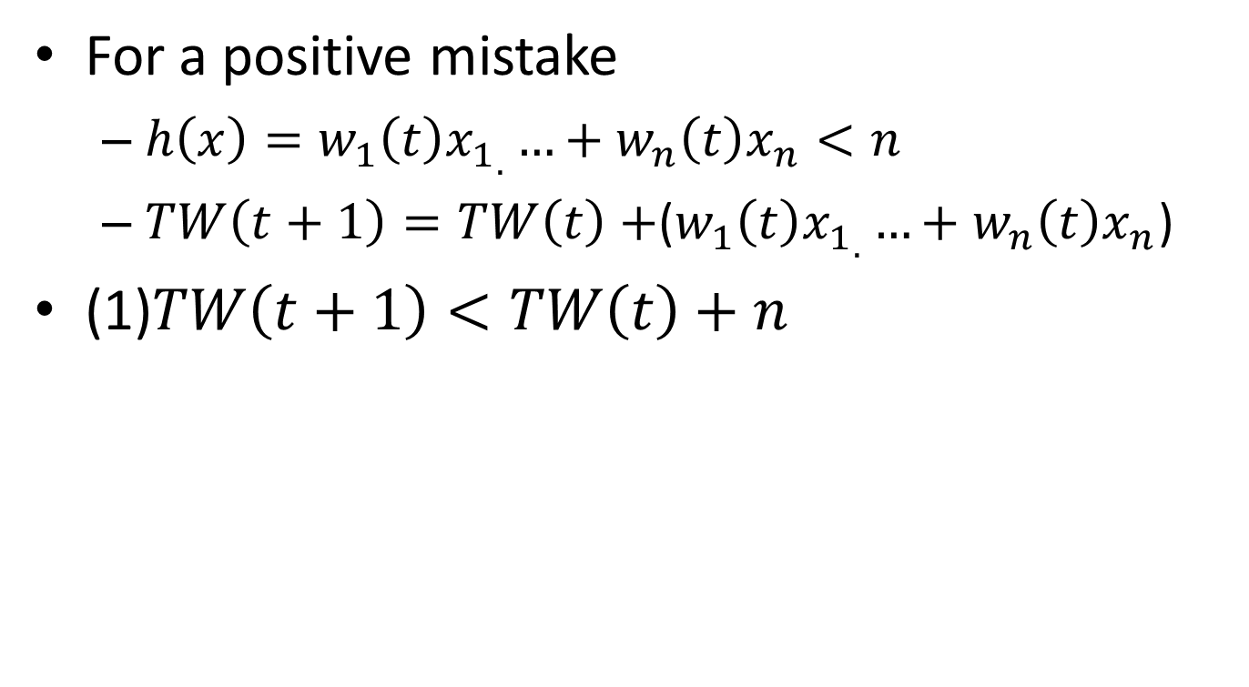
Winnow Proof: Positive Mistakes
For a positive mistake
$h\left(x\right)=w_{1}\left(t\right){x_{1}}_{.}…+w_{n}\left(t\right)x_{n}<n$
$TW\left(t+1\right)=TW\left(t\right)+$($w_{1}\left(t\right){x_{1}}_{.}…+w_{n}\left(t\right)x_{n}$)
(1)$TW\left(t+1\right)<TW\left(t\right)+n$

Slide 49
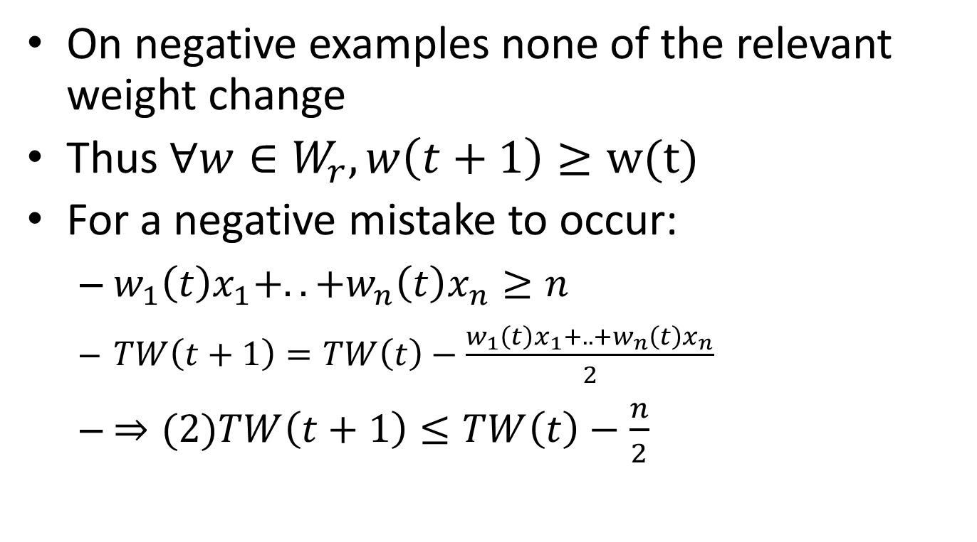
Winnow Proof: Negative Mistakes
On negative examples none of the relevant weight change
Thus $∀w∈W_{r}, w\left(t+1\right)≥w(t)$
For a negative mistake to occur:
$w_{1}\left(t\right)x_{1}+..+w_{n}\left(t\right)x_{n}≥n$
$TW\left(t+1\right)=TW\left(t\right)−\frac{w_{1}\left(t\right)x_{1}+..+w_{n}\left(t\right)x_{n}}{2}$
$⇒(2)TW\left(t+1\right)≤TW\left(t\right)−\frac{n}{2}$

Slide 50
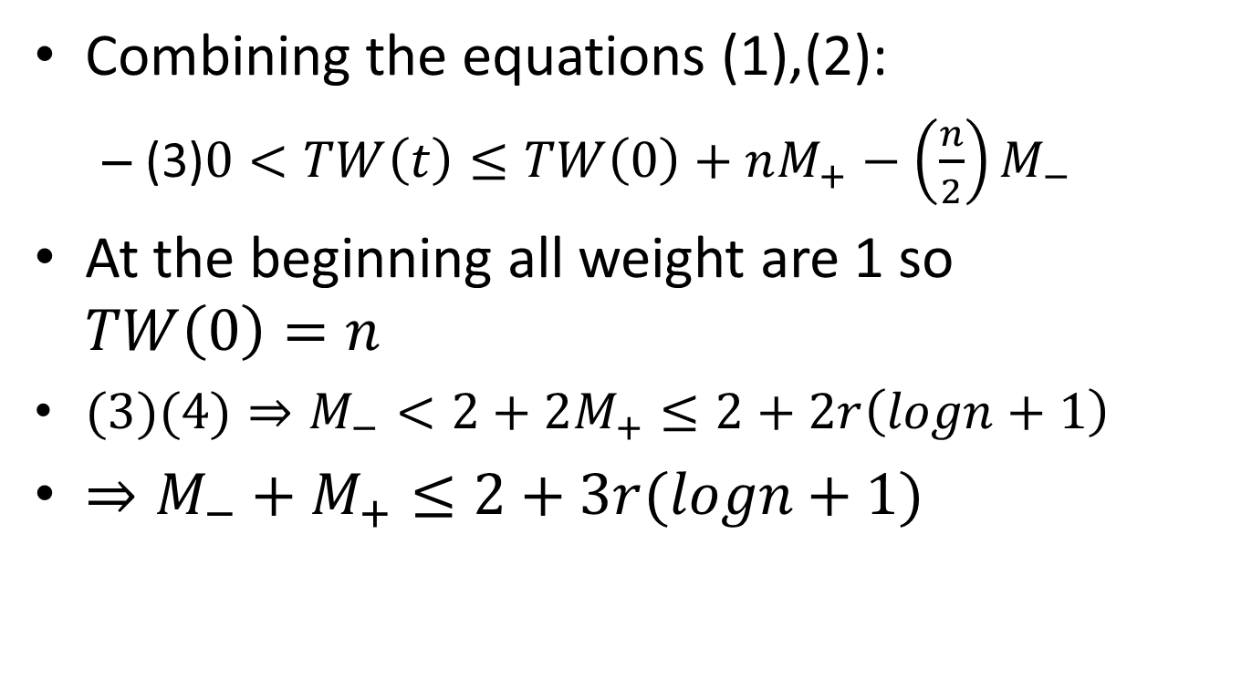
Winnow Proof:Cont.
Combining the equations (1),(2):
(3)$0<TW\left(t\right)≤TW\left(0\right)+nM_{+}−\left(\frac{n}{2}\right)M_{−}$
At the beginning all weight are 1 so $TW\left(0\right)=n$
$(3)(4)⇒M_{−}<2+2M_{+}≤2+2r\left(logn+1\right)$
$⇒M_{−}+M_{+}≤2+3r(logn+1)$

Slide 51
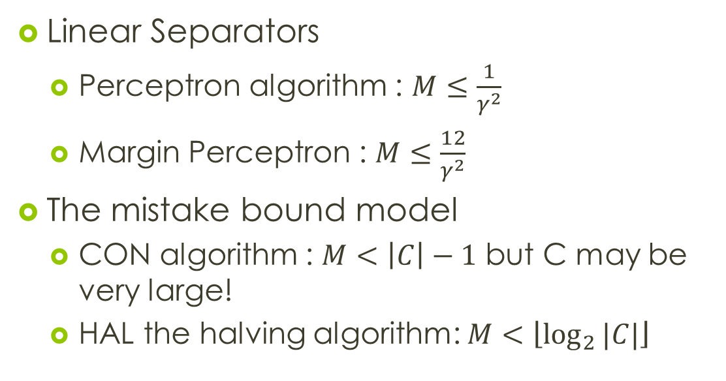
What should we know? I
Linear Separators
Perceptron algorithm : $M≤\frac{1}{γ^{2}}$
Margin Perceptron : $M≤\frac{12}{γ^{2}}$
The mistake bound model
CON algorithm : $M<\left|C\right|−1$ but C may be very large!
HAL the halving algorithm: $M<\left\lfloor \log_{2}{|C|}\right\rfloor$

Slide 52
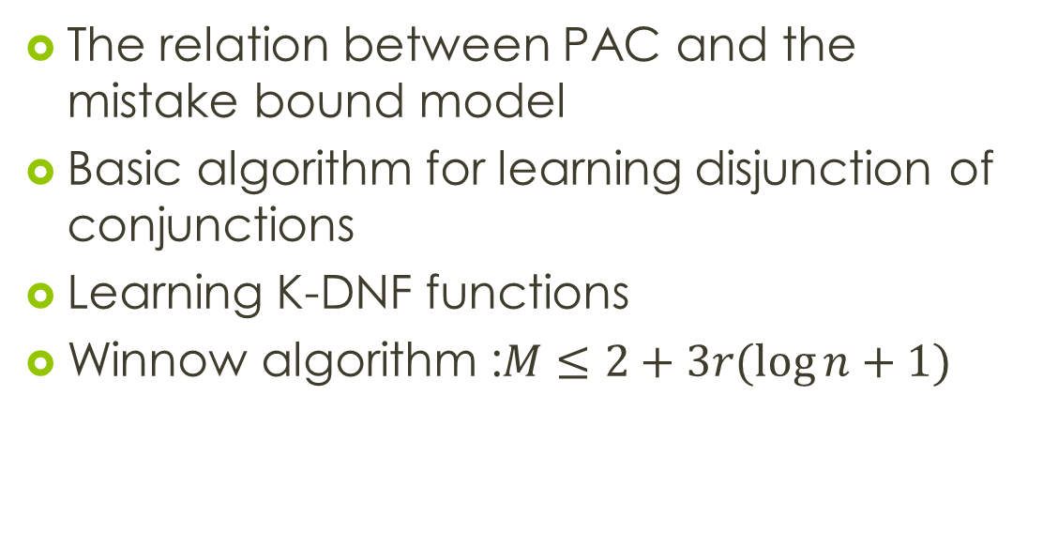
What should you know? II
The relation between PAC and the mistake bound model
Basic algorithm for learning disjunction of conjunctions
Learning K-DNF functions
Winnow algorithm :$M≤2+3r(\log{n}+1)$

Slide 53
Questions?

